Slide 1

Presentation On
“Solar Tracker System”
Course : “Computer Peripherals and Interfacing Lab”
Course Code : CSEL-3208
Presented By,
Presented To,
Name : AMINUL ISLAM RAFI
ID : B-180305022
Dr. ……………
Associate Professor
Dept. Of CSE Jagannath University
Name : MD. RAIHAN KARIM PRIYO
ID : B-180305046

Slide 2

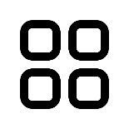
List of Contents
01
Problem
02
Introduction
Demonstration
07
03
Objectives
Testing
08
04
Methodology
Future Work
09
05
Components
References
10
06
Implementation

Slide 3
Problem
Build a solar panel system that can track the sun, automatically move its panel to the direction of sun light and consume maximum sun light while producing maximum electric energy.
Why??
The position of the traditional solar panels are fixed. But the sun moves around the globe. Hence, the traditional solar panels can’t consume maximum sun light and can’t produce maximum electric energy.

Slide 4
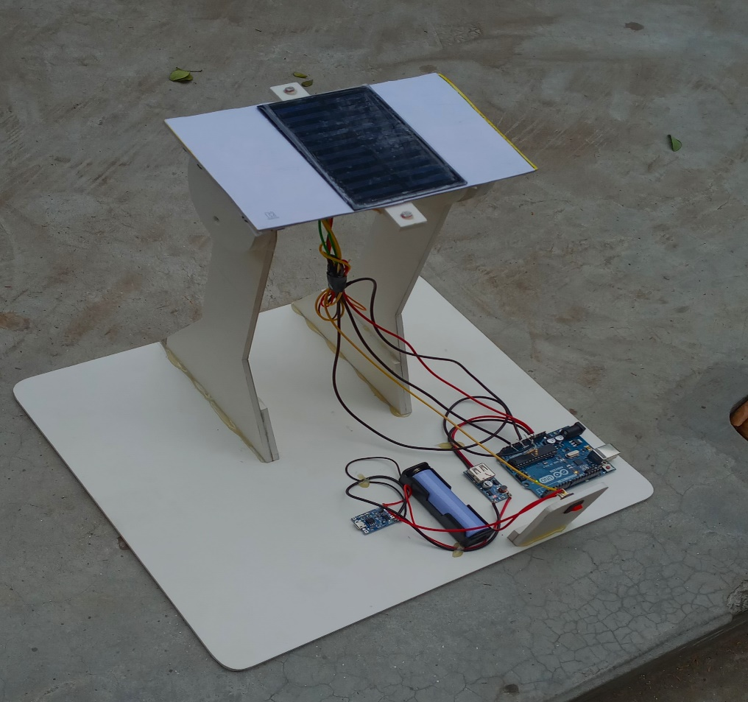
Solution
The “Solar Tracker System”

Slide 5
Introduction
Focuses on the optimization
of the electric energy produced by the photovoltaic cells of the solar panel
Always receives sunlight to the fullest extent
Solar tracking system has 30% higher power gain
Track the sunlight and rotate the solar panel automatically.
1
2
3
4

Slide 6


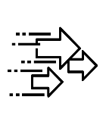


Objectives
Automate
Non-computer Environment
01
02
03
04
Able to run on single axis.
Low power
consumption
Save Manpower

Slide 7
Methodology
Data collection method:
The data is intensity of sun light
Using two sensors compute the intensity of the sun light
Data analysis:
Compare the intensity of the sensors via a program
Process:
Move the panel to the direction of the sensor with more light intensity

Slide 8
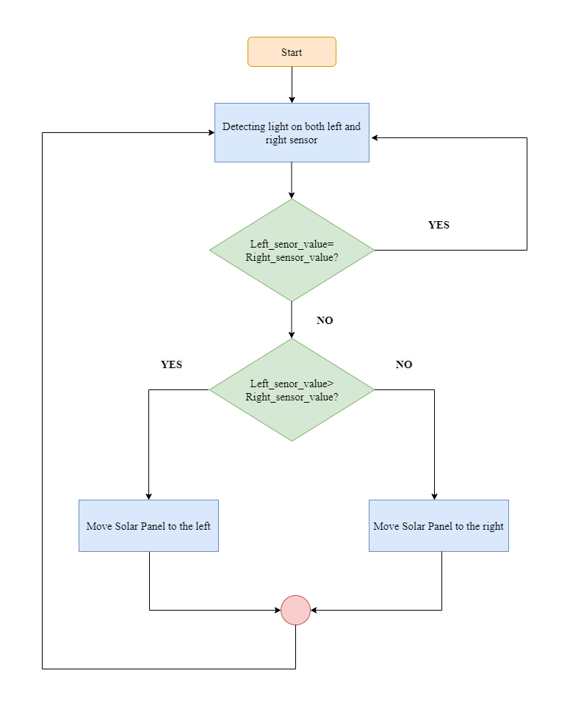
Methodology

Slide 9














Methodology
Morning time
Left sensor value >right sensor value
East
left sensor value
Solar panel
Right sensor value
Servo Motor
Microprocessor
Battery

Slide 10
Methodology
Morning time
Left sensor value =right sensor value
East
West
Right sensor value
Solar Panel
left sensor value
Servo Motor
Microprocessor
Battery

Slide 11
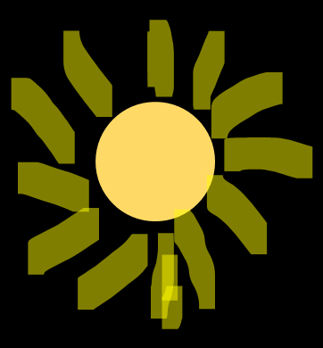
Methodology
Noon time
Left sensor value <right sensor value
East
West
Right sensor value
Solar Panel
left sensor value
Servo
Motor
Microprocessor
Battery

Slide 12
Methodology
Noon time
Left sensor value =right sensor value
East
West
left sensor value
Solar Panel
Right sensor value
Servo
Motor
Microprocessor
Battery

Slide 13
Methodology
Afternoon time
Left sensor value < right sensor value
East
West
left sensor value
Right sensor value
Solar panel
Servo Motor
Microprocessor
Battery

Slide 14
Methodology
Afternoon time
Left sensor value = right sensor value
East
left sensor value
West
Right sensor value
Solar panel
Servo Motor
Microprocessor
Battery

Slide 15
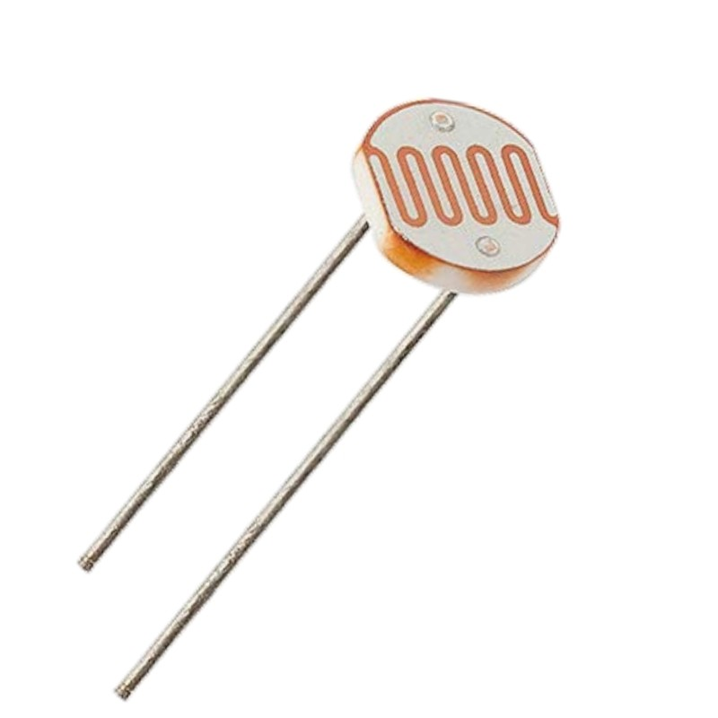
Components
Tool
It has two terminal (No Positive or Negative)
Cadmium sulphide is present between two terminal so that it can give high resistance.
When light intensity is high than resistance is low and more current provide between LDR.
When light intensity is low than resistance is High and Less current provide between LDR.
1
LDR
Sensor

Slide 16
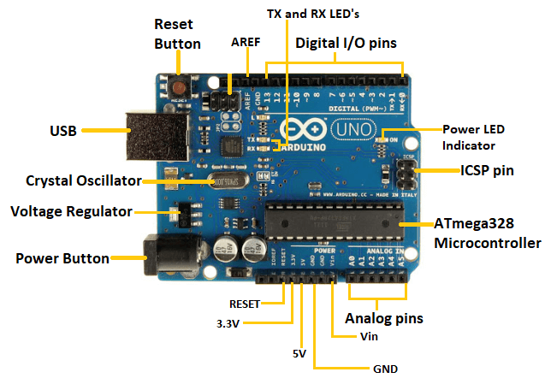
Components
Tool
2
Arduino
UNO

Slide 17
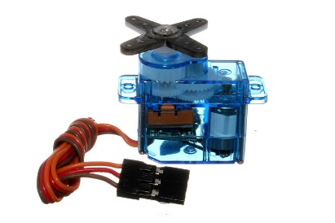
Components
Tool
3
A servo motor is a type of motor that can rotate with great precision. Normally this type of motor consists of a control circuit that provides feedback on the current position of the motor shaft, this feedback allows the servo motors to rotate with great precision
Mini Servo
Motor SG90

Slide 18
Components
Tool
Tool
Tool
Tool
4
5
6
7
PVC
Boards
Voltage Boost
Up Module
Battery Holder
&
Battery
Solar Panel

Slide 19
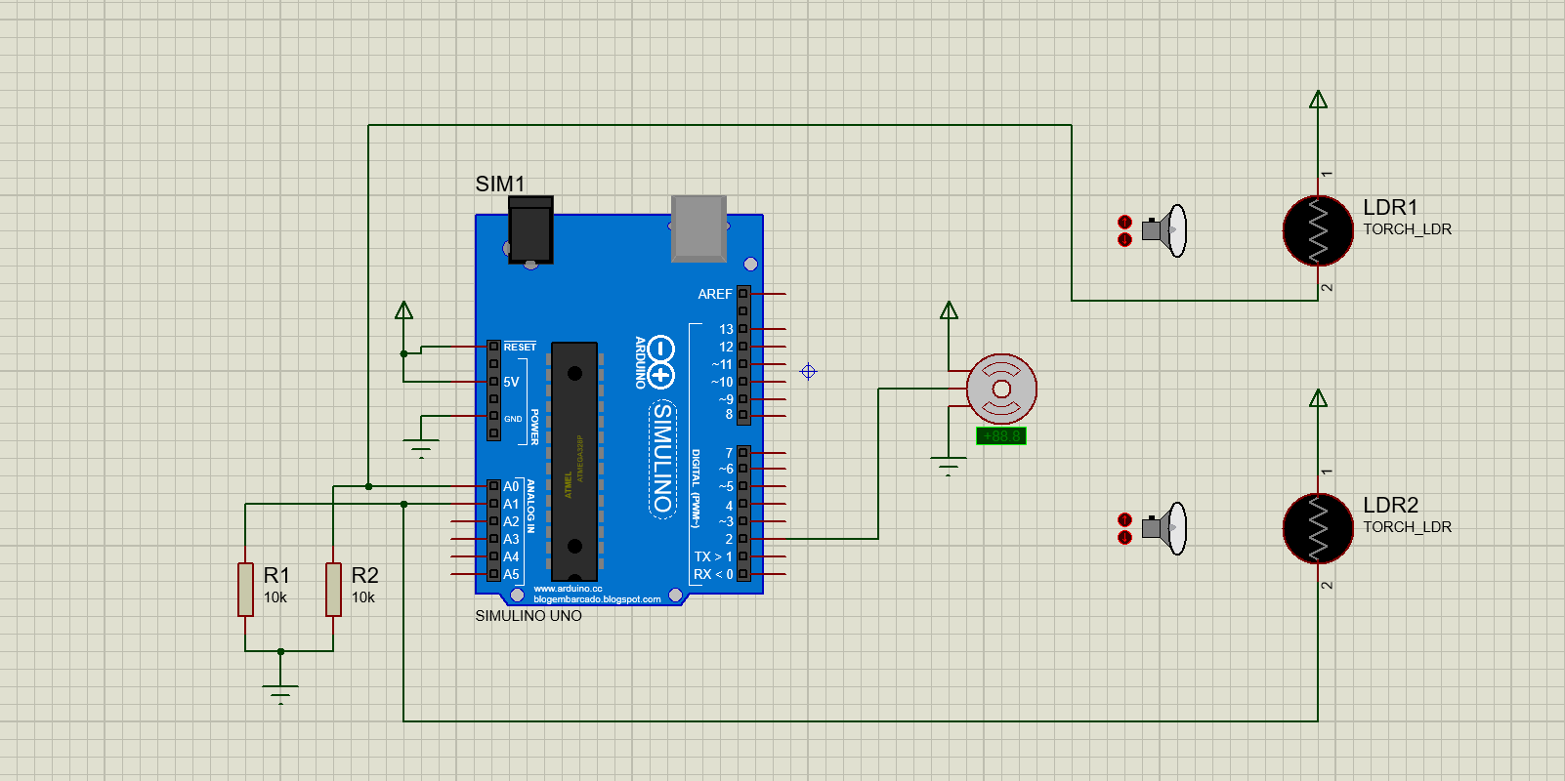
Implementation
Proteus Simulation

Slide 20
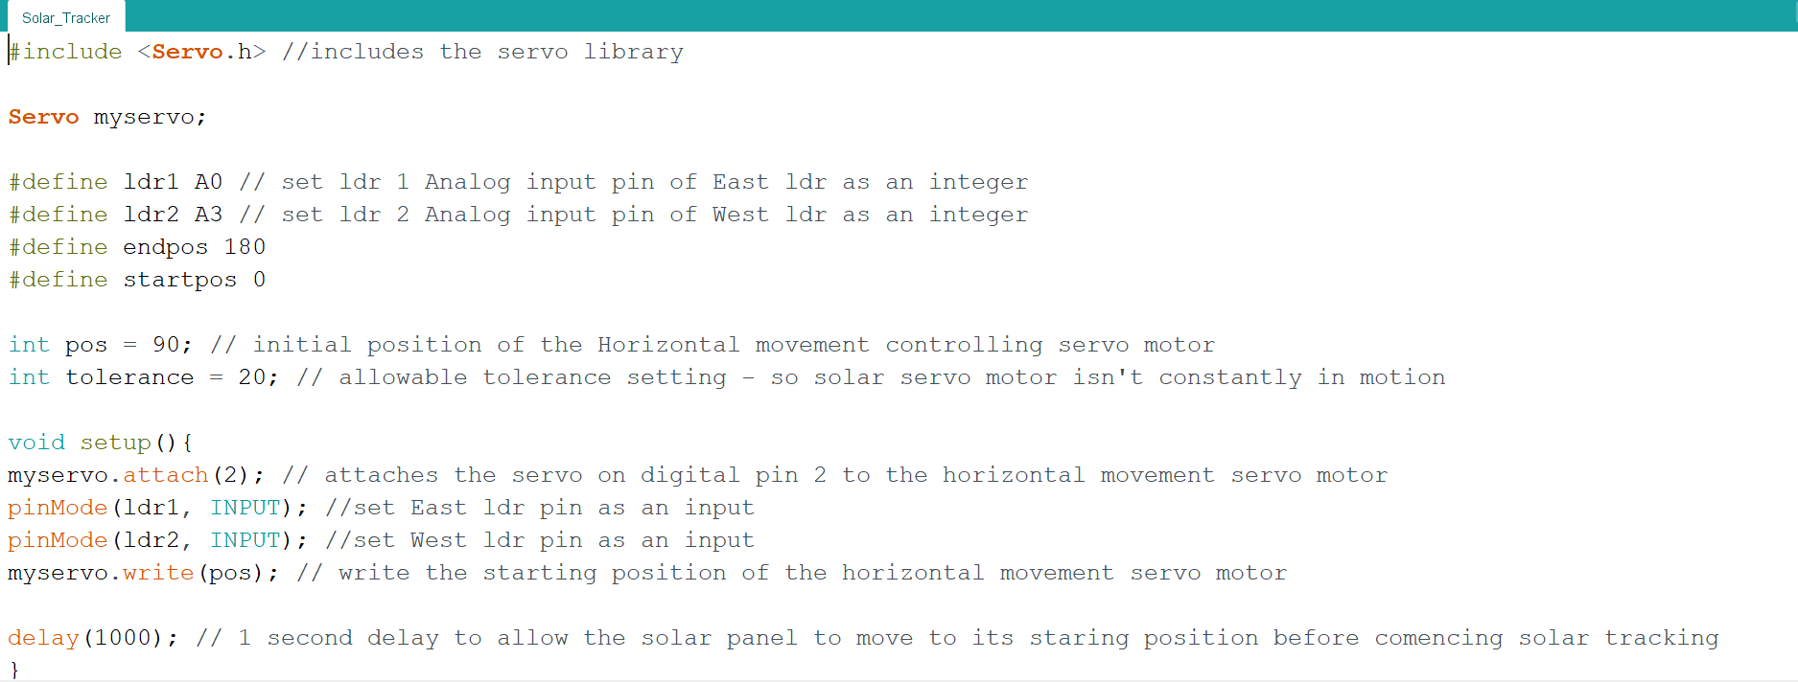
Implementation
Code

Slide 21
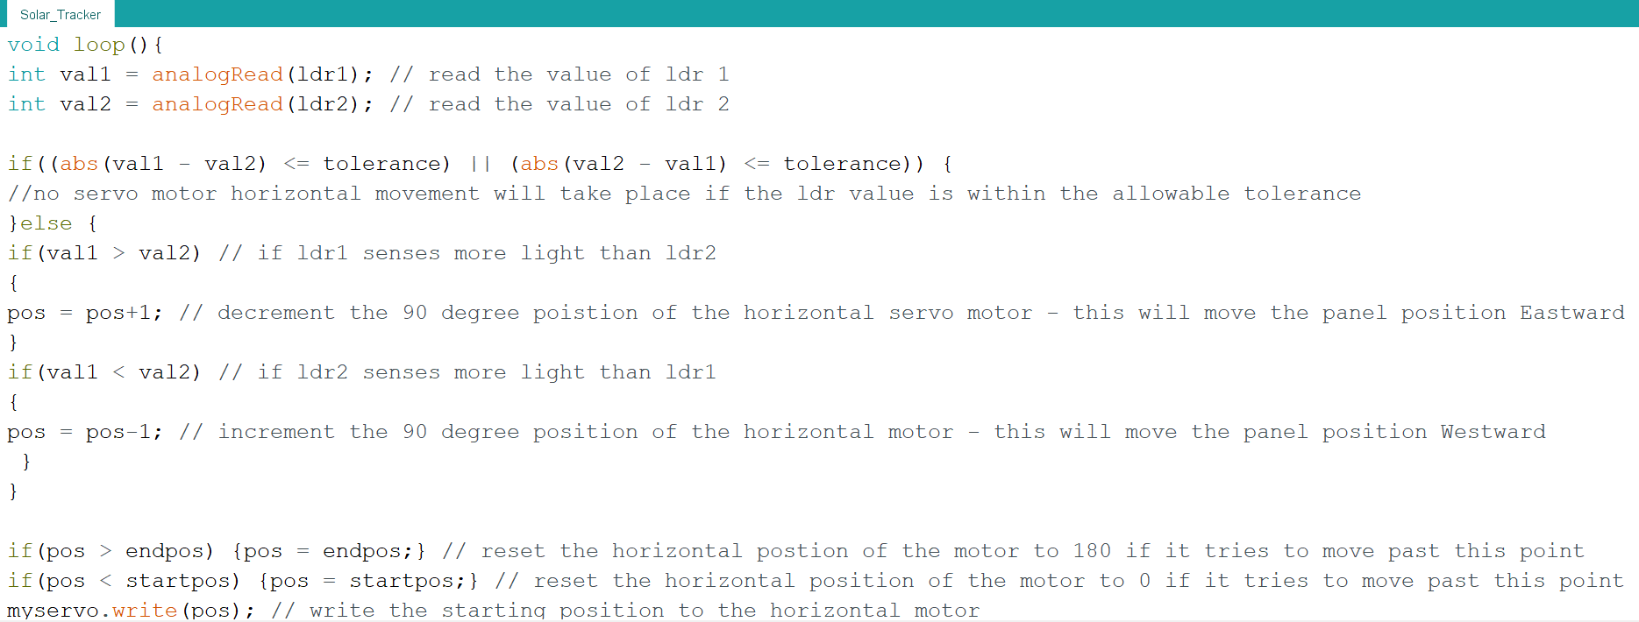
Code

Slide 22
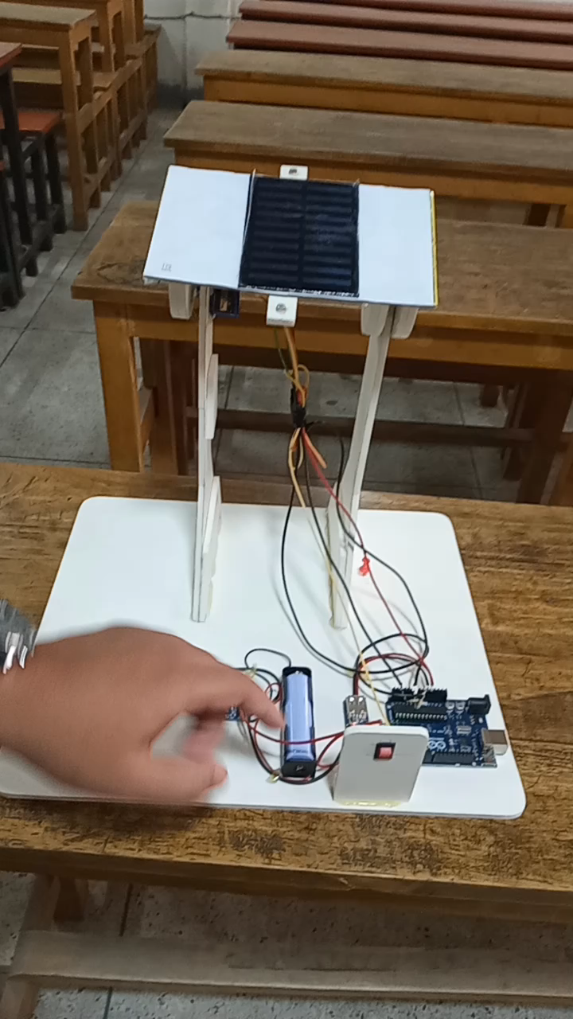
Demonstration
(Video)

Slide 23
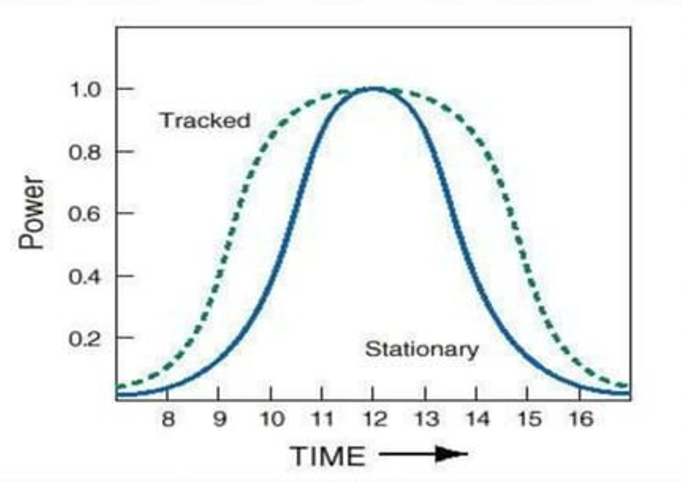
Comparison

Slide 24
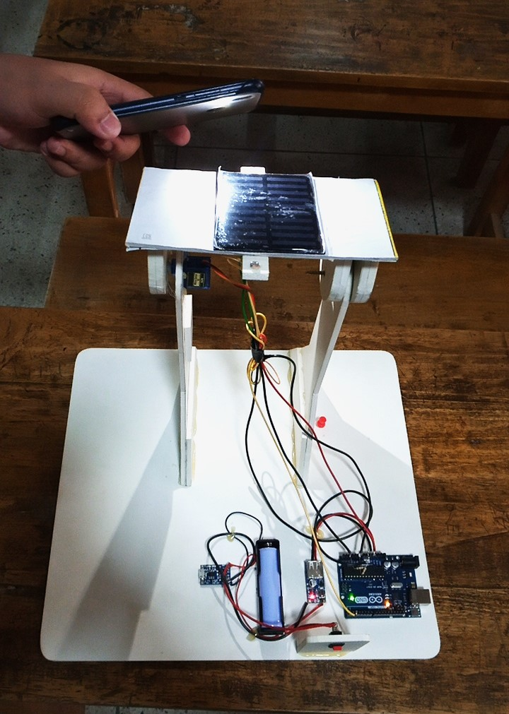
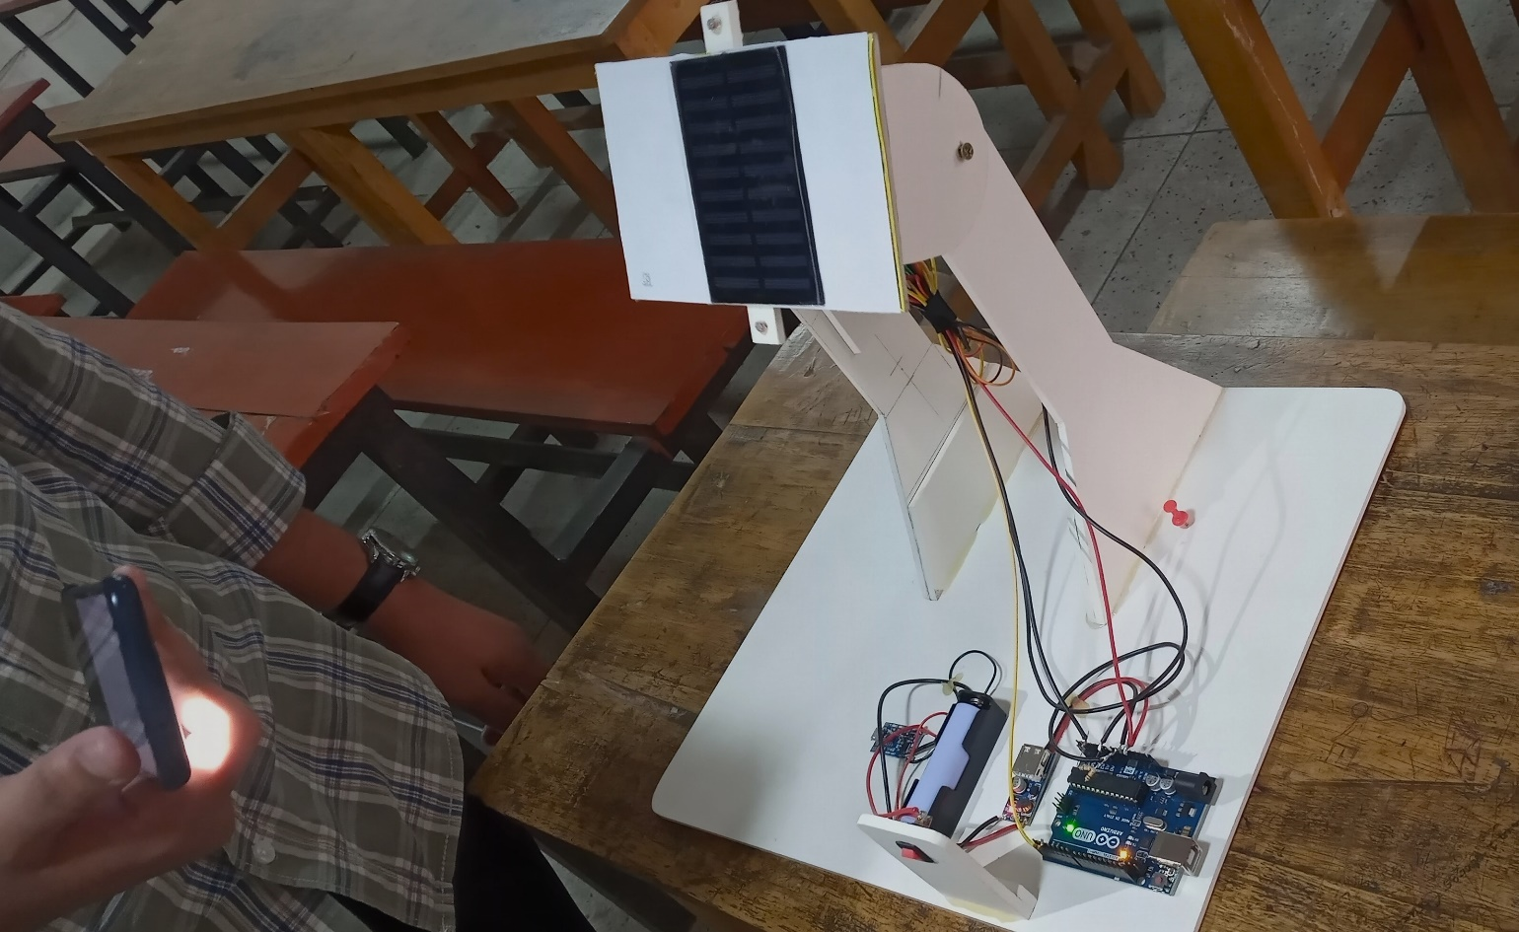
Testing
Tested in a room using light generated from smart phone.

Slide 25
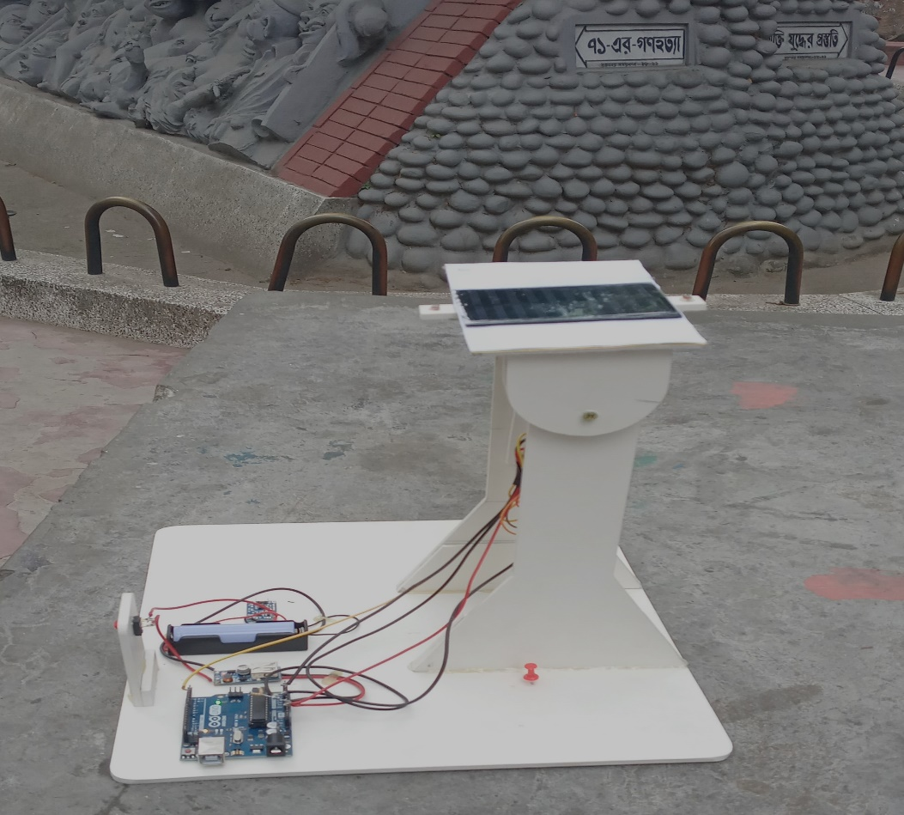
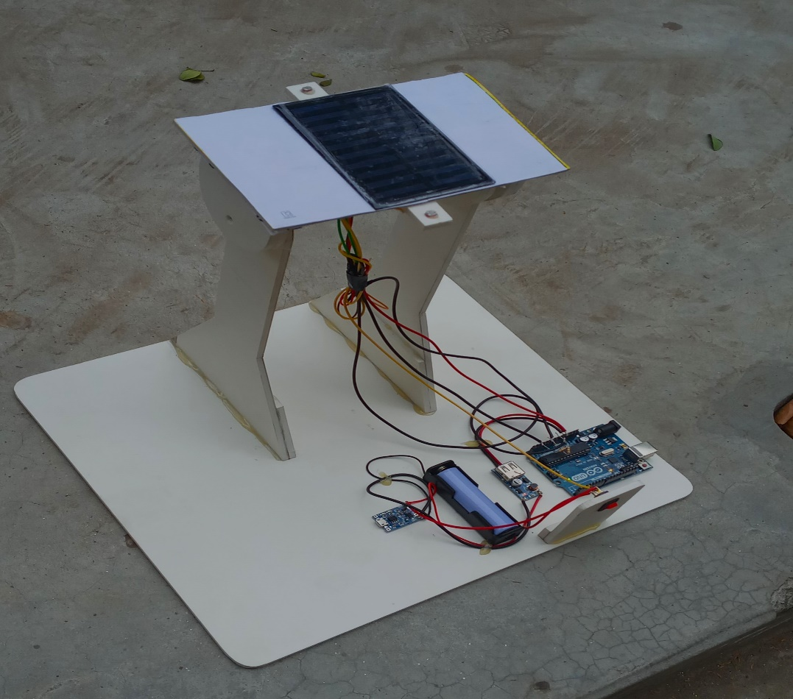
Testing
Tested in real world using sun light.

Slide 26
Future Work
1
Double axis tracking(Vertical and Horizontal)
Future Work
2
Better design
and Portability

Slide 27
Conclusion
STS system help us improve the performance of solar system in a simple way.
Improved the utilization rate of solar energy and efficiency of photovoltaic power
generation system.

Slide 28
References
Khan, Md Tanvir Arafat, et al. "Design and construction of an automatic solar tracking system."
International Conference on Electrical & Computer Engineering (ICECE 2010). IEEE, 2010.
Hafez, A. Z., A. M. Yousef, and N. M. Harag. "Solar tracking systems: Technologies and trackers drive types–A review."
Renewable and Sustainable Energy Reviews 91 (2018): 754-782.

Slide 29
THANK YOU

